Slide 1
Software Security CS 595

Slide 2
Iranian Pupy RAT -
A Malware Analysis
Presented by:
Lavanya Juvvala A20442790
Sainath Macharla A20445645

Slide 3
Table of Contents
Introduction and working of Iranian Pupy RAT
Methodology : Phishing Attack
What are Macros?
Working and Setup
Tool: What is OfficeMalScanner?
Execution and malware Analysis
Observations
Future work
References

Slide 4
Introduction
What is Pupy RAT?
Pupy is classified as a RAT(Remote Access Trojan).
It is a multi-platform (Windows, Linux, OSX, Android), multi- function RAT and post-exploitation tool mainly written in python.
The whole Python interpreter is fully loaded from memory so there may be little to no trace on the disk of a computer.
Pupy can communicate using multiple transports, load remote python code, python package and python C- extensions from memory.
It could easily be implemented to stay hidden on a system and steal sensitive information as an APT (Advanced Persistent Threat).

Slide 5
Working
The attackers from COBALT GYPSY group used phishing lures to distribute Iranian PupyRAT.
This was first detected by the Secureworks Counter Threat Team(CTU) in early January 2017.
Victim opens the mail and clicks on the link from the phishing mail and downloads a document on the local system.
The downloaded document attempts to run a macro which in turn runs a PowerShell command.
This command downloads two additional PowerShell scripts that install PupyRAT, an open-source remote access trojan (RAT).
This creates a back-door for the attackers to exploit the victim’s system.

Slide 6
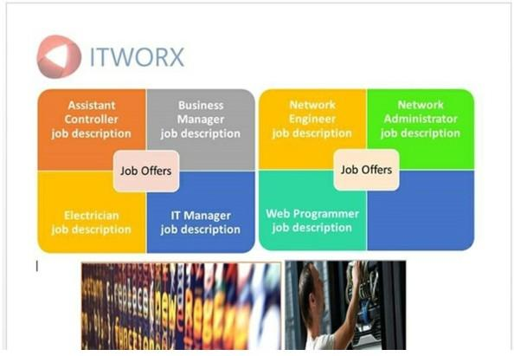
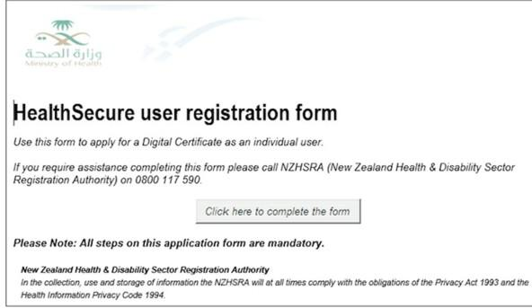
Methodology : Phishing Attack
Screenshots of the malicious emails from the phishing attack.
On clicking these links, a macro which is enabled behind the forms runs few scripts on the victim machine which gives a backdoor to the attacker .

Slide 7
Macros: Definition and Uses
Macro
Macro (which stands for "macro instruction") is a predefined set of commands that will run with the appropriate execution criteria
A shortcut that performs multiple instruction in one step
VB programs can run executables with different additional instructions
Macros can be used to make tasks less repetitive by representing a complicated sequence of keystrokes, mouse movements, commands, or other types of input
Macros are a set of actions that can be used to automate tasks

Slide 8
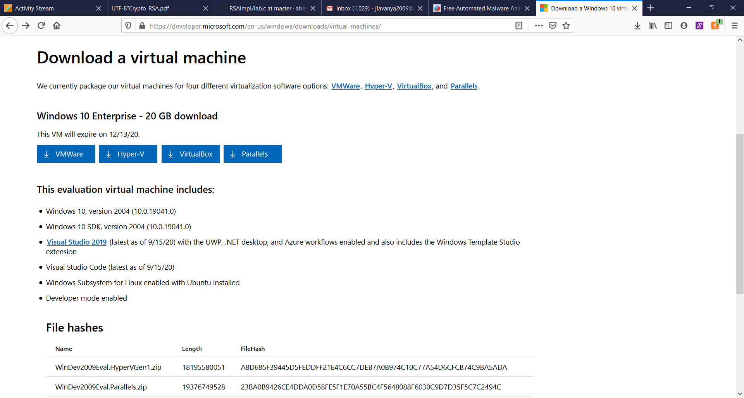
Setup Work Environment
Download WINDOWS 10 Virtual Machine for malware analysis
We have used VMWare for this project

Slide 9
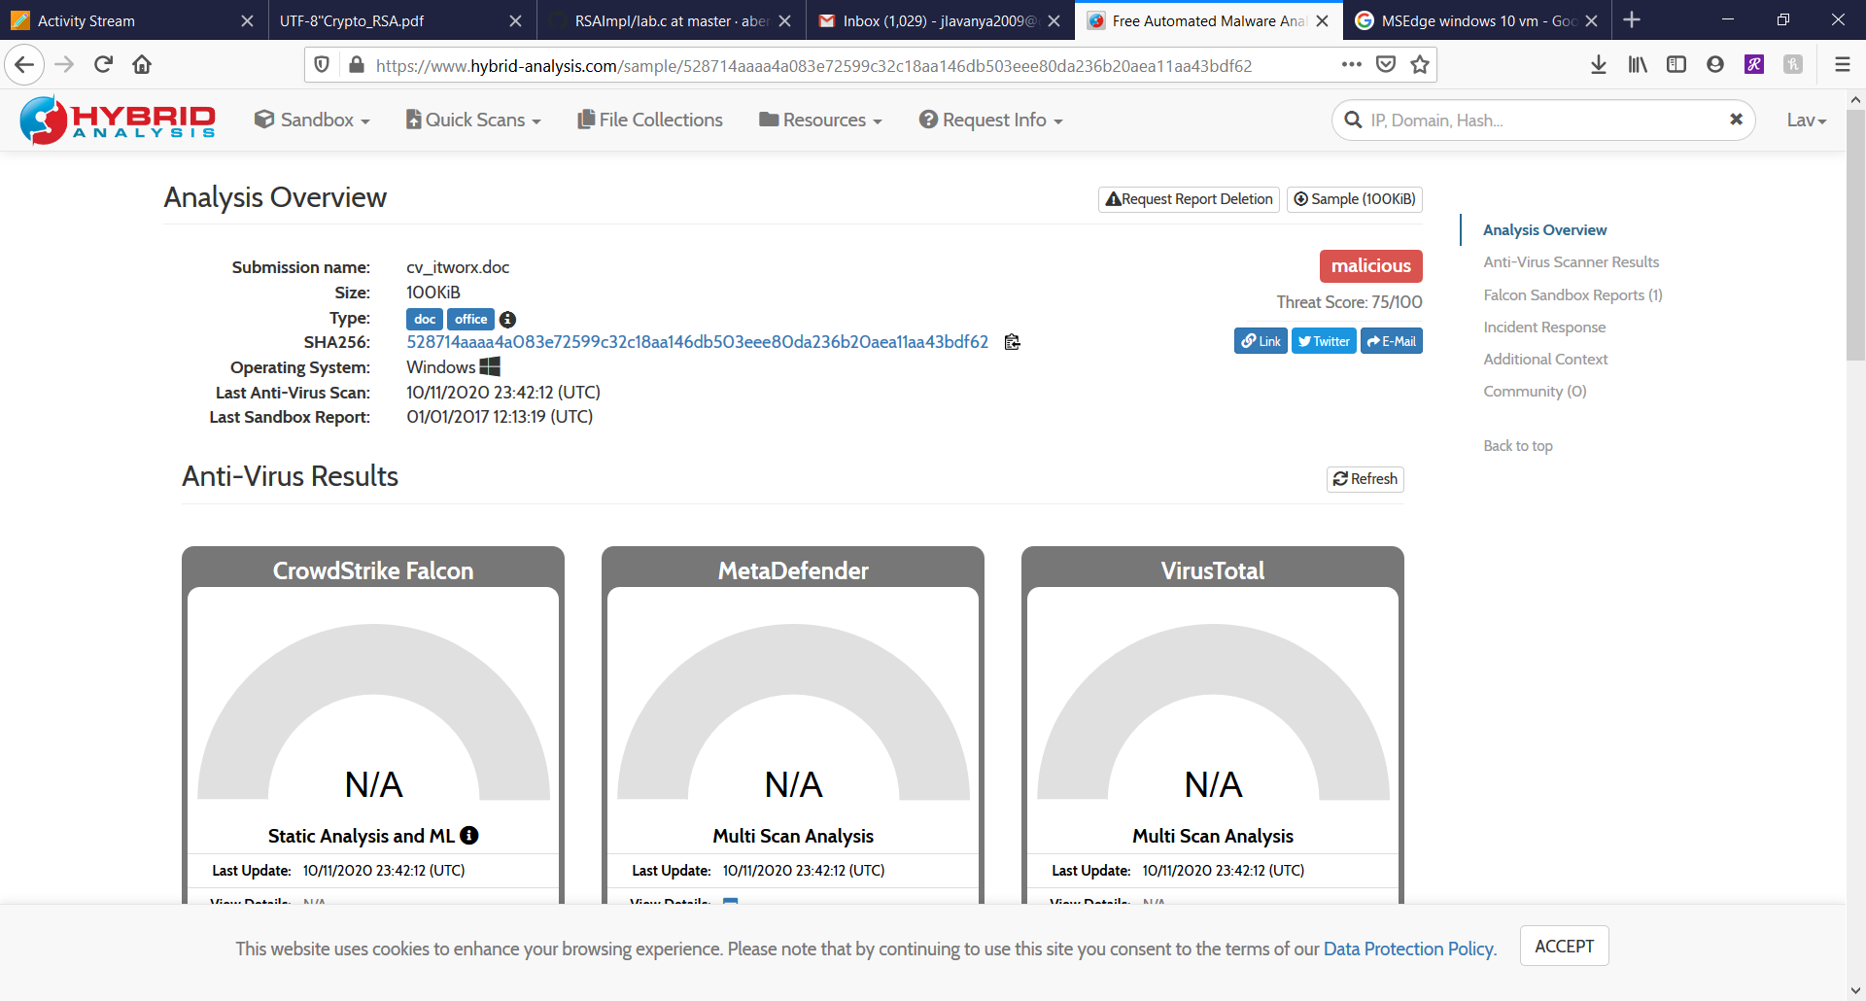
Setup Work Environment
3. Register an account on the Hybrid Analysis website

Slide 10
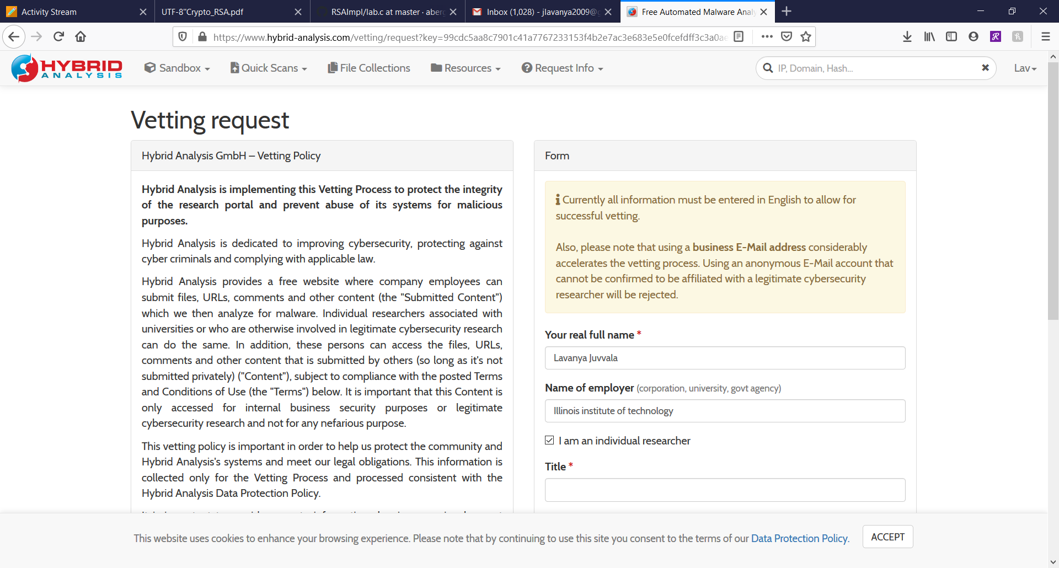
Setup Work Environment
4. Fill in the vetting request and get the approval link to the assigned email.
5. Download the Iranian Pupy Rat malware file on the VM.

Slide 11
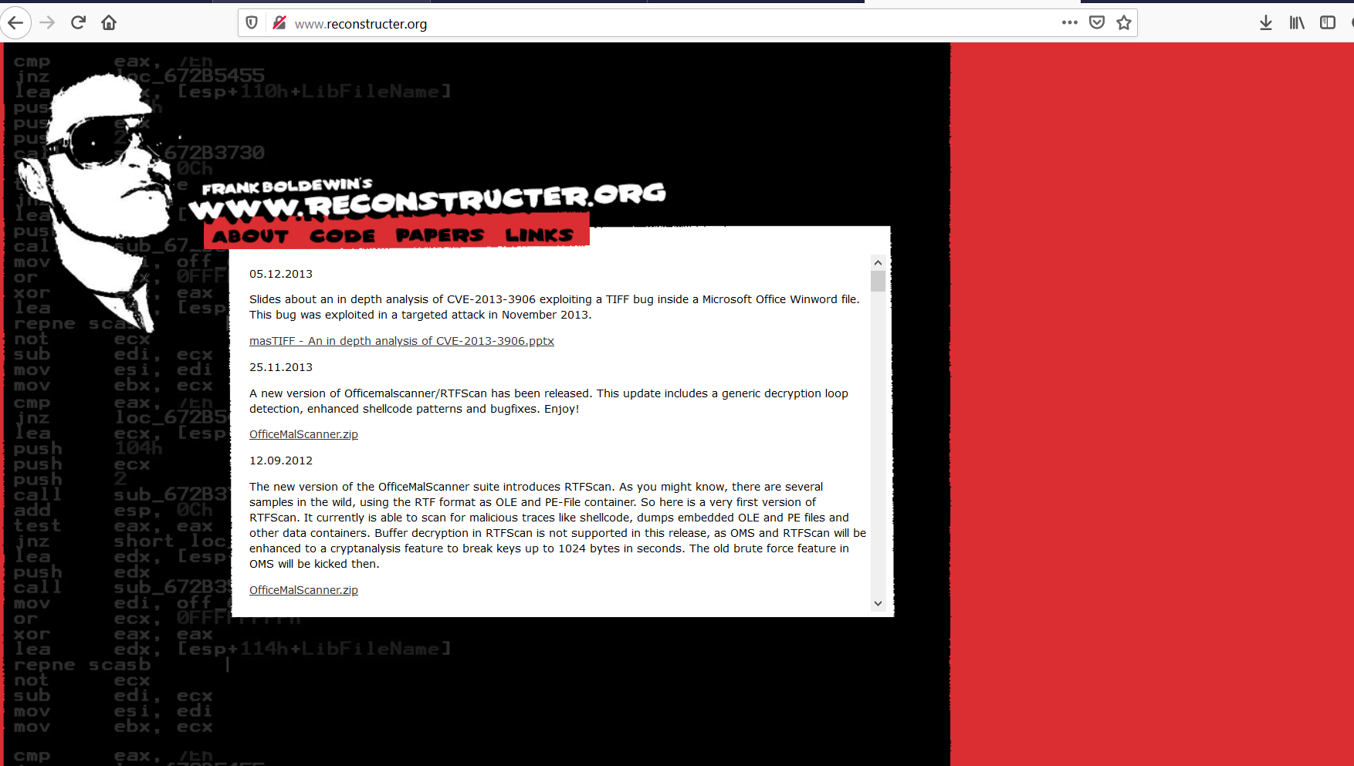
Setup Work Environment
6. Download OfficeMalScanner on the Windows VM from “ reconstrucer.org”

Slide 12
Tools: OfficeMalScanner
Forensic tool to scan Microsoft Office files
It can scan for malicious macros (VBA) and embedded portable executable (PE) files
The tool is suitable for scanning
Microsoft Word (*.doc, *.docx)
Microsoft Excel (*.xls, *.xlsx)
Microsoft Powerpoint (*.ppt, *.pptx)
The toolkit includes
RTFScan
Mal-Host Setup
DisView

Slide 13
OfficeMalScanner : Syntax , Options
Syntax:
OfficeMalScanner <PPT, DOC or XLS file> <scan | info> <brute> <debug>
Options
scan
scan for several shellcode heuristics and encrypted PE-Files
info
dumps OLE structures, offsets+length and saves found VB-Macro code
inflate
decompresses Ms Office 2007 documents, e.g. docx, into a temp dir

Slide 14
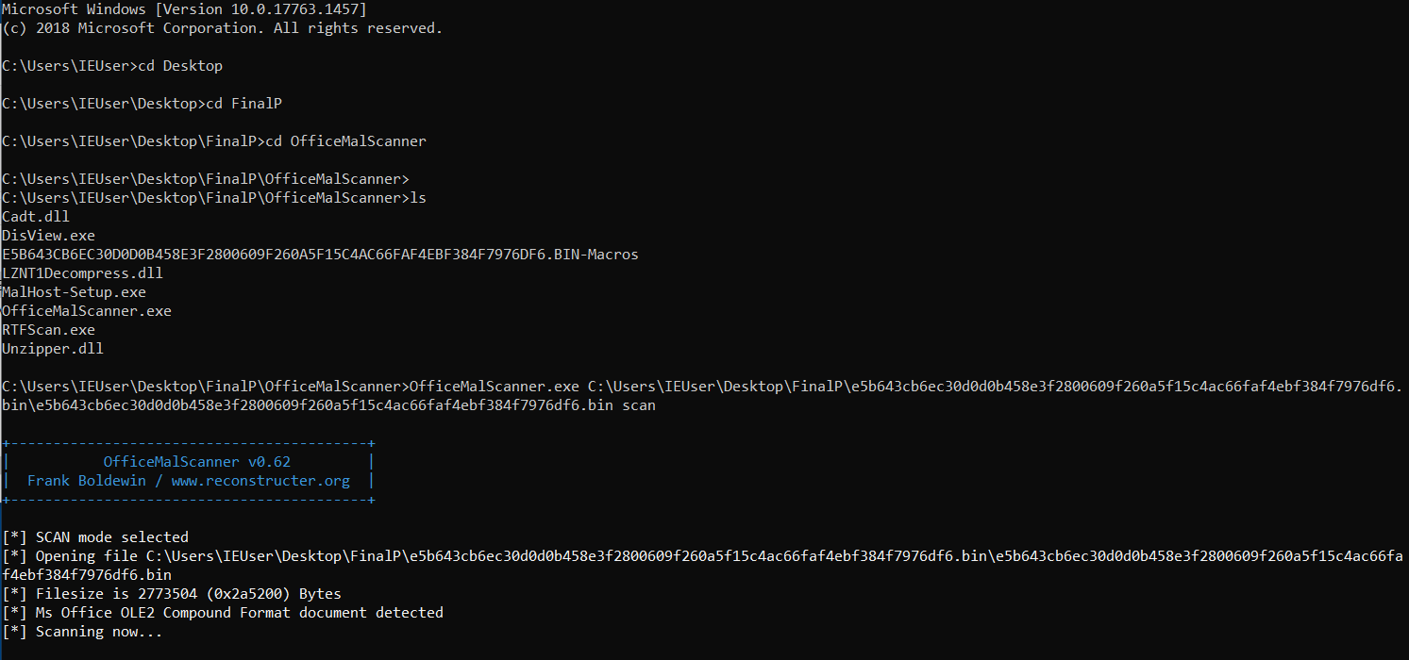
EXECUTION
Run the command prompt
Start OfficeMalScanner and execute the following statements to extract macros
scan option is selected

Slide 15
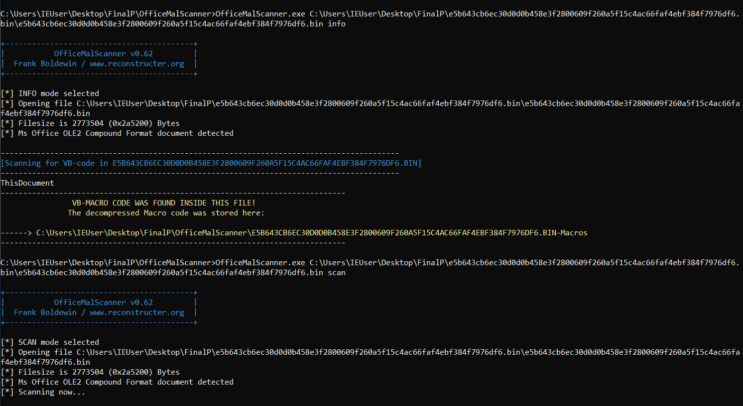
EXECUTION
Info option is selected
info option is selected

Slide 16
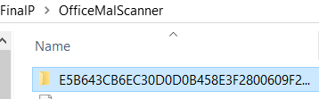
EXECUTION
The decompressed macro code is stored in the OfficeMalScanner folder

Slide 17
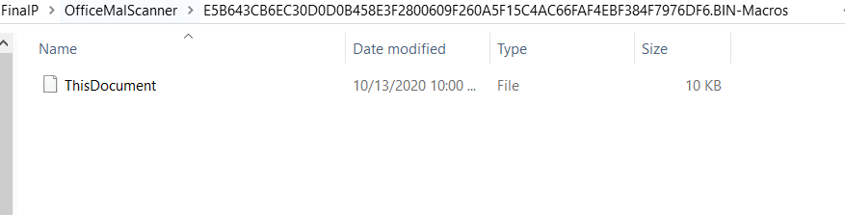
EXECUTION
Inside the above folder, we find the document “ThisDocument” which runs the macros

Slide 18
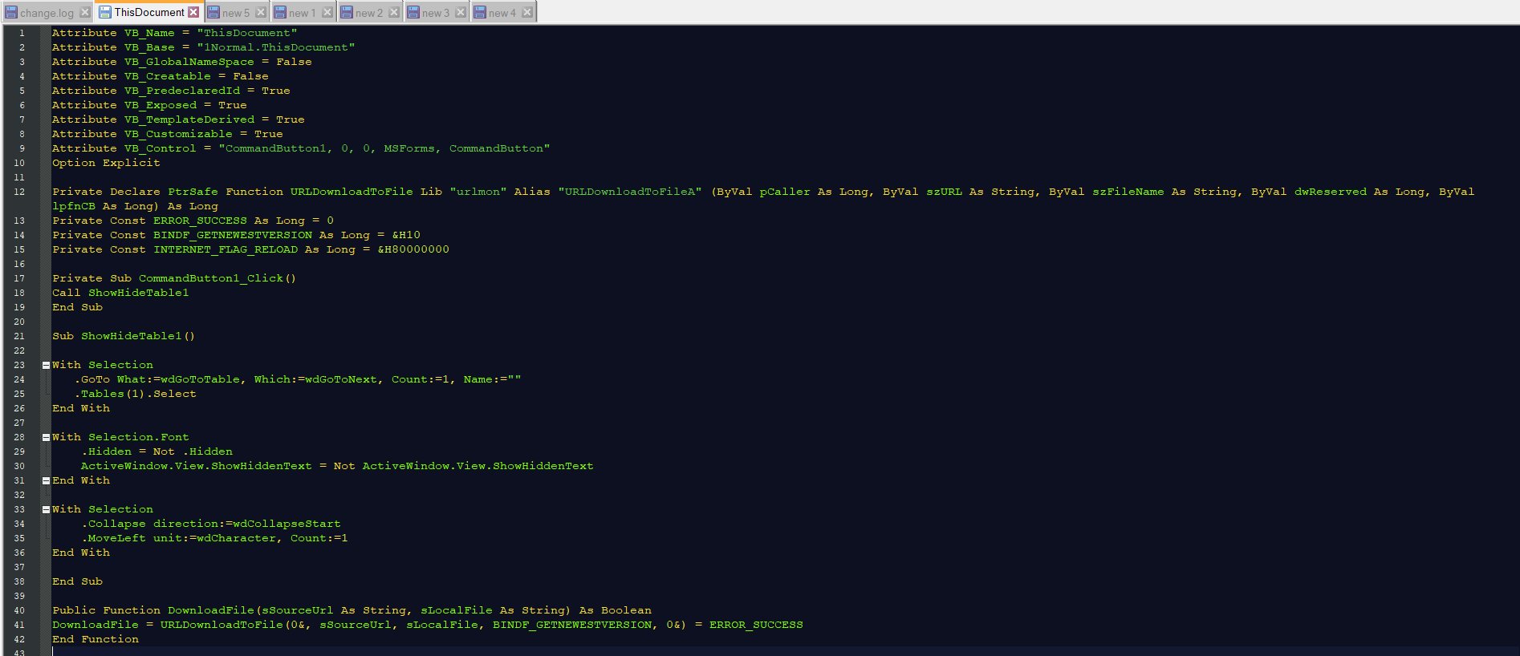
Opening this document in Notepad++ for analyzing, these are the observations:

Slide 19
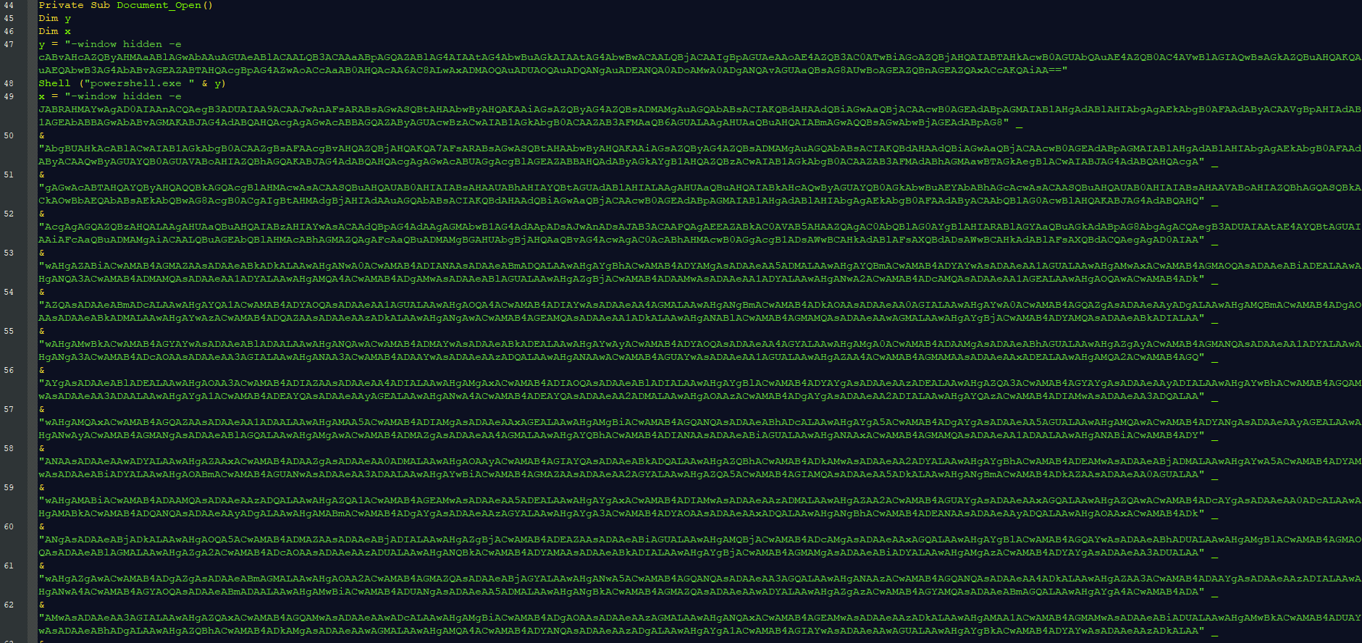

Slide 20
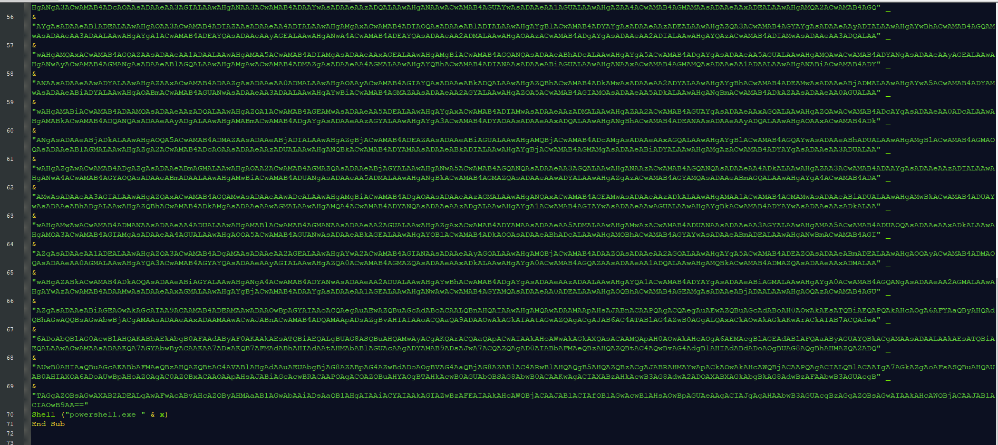

Slide 21
Observations
Windows VM setup
Register in Hybrid analysis website and request the malware file for analysis
Download and install OfficeMalScanner in the VM
Scan PupyRat malware file
Open document in Notepad++ and notice it’s encoded
Two parameters x and y are found post further analysis which contains strings ending with “==” indicating it’s encoded in base64
Once the parameters are decoded more layers of encoding may be found
Using python for further decoding of x and y parameters
Parameters indicate the presence of powershell scripts

Slide 22
Future Work
Analysis of decoded code snippets
Observing powershell script functionality
Consequences of executing these scripts
Effects of the attack
Mitigation strategies
Limitations of our work

Slide 23
References
https://www.codeproject.com/Articles/325776/The-Art-of- Win32-Shellcoding
http://www.reconstructer.org/
ttps://www.secureworks.com/blog/iranian-pupyrat-bites- middle-eastern-organizations
https://sensorstechforum.com/pupy- rahttps://sensorstechforum.com/pupy-rat-description-and- removal/t-description-and-removal/

Slide 24
Thank You

